Slide 1

LICENSE PLATE RECOGNITION
BMS College of Engineering
Department of Information Science and Engineering
CAPSTONE PROJECT PHASE -1
Review - II
Under the Guidance of
Prof. MAHALAKSHMI B S
Assistant Professor
Department of ISE
Batch No -
Team Members :
Aditya Srivastava (1BM19IS011)
Shiven Swaroop (1BM19IS148)
Siddharth Manoj (1BM19IS157)

Slide 2
INTRODUCTION
Increasing need for reliable vehicle identification and tracking systems as well as the technology's many practical uses, license plate recognition has received a great deal of attention recently.The necessity for better traffic management, parking management, security, and surveillance as a result of the rise in vehicle populations has made license plate recognition a vital component of contemporary technology. This project offers a thorough examination of the conception and execution of a deep learning-based automated license plate recognition system. License plate recognition system makes a significant contribution to the field of computer vision by offering a remedy for the issue of accurate and efficient vehicle tracking and identification.

Slide 3
MOTIVATION
The motivation of license plate recognition is mainly driven by the increasing demand for tracking systems and vehicle identification.The ability to quickly and precisely identify license plate numbers has emerged as a critical component of contemporary technology as a result of the development in vehicle populations and the corresponding rise in the demand for better traffic control, parking management, security, and surveillance.

Slide 4
EXISTING SYSTEM
The existing system for vehicle identification, license plate recognition and tracking mostly relies on manual methods, like manual entering of data into computer systems or license plate inspections by security officers.
Disadvantages of the Manual System:
Time Consuming
Prone to error
Limited tracking capabilities
Inefficient

Slide 5
LITERATURE SURVEY
Sl no. | Title of the paper | Problem Addressed | Authors Approach / Method | Results
1. | License number plate recognition system using entropy-based features selection approach with SVM | LPR gets affected by factors such as light variations, occlusion, and multi-views. | CIE-Lab color space, binary segmentation, Image refinement, Support Vector Machine | Accuracy achieved is maximum up to 99.5%
2. | Analyzing passenger and freight vehicle movements from automatic-Number plate recognition camera data | Provide a better understanding of passenger and freight vehicle movements and stops, identifying similarities and differences between vehicle categories | Inductive loops, Bluetooth detectors, Floating Car Data (FCD), and ANPR cameras | Time restrictions affect the different vehicle categories’ actions

Slide 6
3. | Automatic Number Plate Recognition for Motorcyclists Riding Without Helmet | Traffic police manually monitoring motorcyclists at road junctions or through CCTV footage and penalizing those without helmet | Helmet detection, number plate recognition, computer vision, machine learning; convolutional neural networks; transfer learning | Experimental results on traffic videos show an accuracy of 98.72% on detection of motorcyclists without helmets.
4. | Real-time Jordanian license plate recognition using deep learning | Develop an accurate ALPR for Jordanian Licence Plate | Two-stage CNNs, YOLO3 framework, ALPR | proposed approach achieved 87% recognition accuracy,
5. | Automatic Vehicle License Plate Recognition using Optimal K-Means with Convolutional Neural Network for Intelligent Transportation Systems | Automatic Vehicle License Plate Recognition | VLPR model,OKM- CNN model,Improved Bernsen Algorithm, Connected component analysis | ensured the effective performance of the OKM-CNN model over the compared methods in a considerable way.

Slide 7
6. | Automatic License Plate Recognition Via Sliding-Window Darknet-Yolo Deep Learning | To recognize Taiwan’s Licence plate | YOLO darknet deep learning framework | Achieves approximately 98.22% accuracy on license plate detection and 78% accuracy on license plate recognition
7. | Automatic License Plate Recognition Technique using Convolutional Neural Network | Purposes an automated system for recognizing license plate technique using Convolutional Neural Network | Image processing, character segmentation, convolutional neural network, character recognition. | LPR using CNN achieved accuracy of 85.83% tested against 555 images
8. | An efficient robust method for accurate and real‑time vehicle plate recognition | Addresses problems like Accuracy and real-timeliness in vehicle plate recognition | AVPR, Plate Detection, CCA, Character recognition, Random Forest | Overall accuracy achieved by the proposed method was 98.27%

Slide 8
9. | License Plate Recognition System | Development of a LPR software system that would be useful in vehicle identification as well as in vehicle parking services and even e challan. | OpenCV, Machine Learning | Ability to recognize the characters correctly on license plate by neural network has probability of 95% even in presence of noise with 50% density
10. | Urban travel time data cleaning and analysis for Automatic Number Plate Recognition | Eliminating outliers in travel times implemented in real time to enhance the data quality for traffic network monitoring and management. | Automated Number Plate Recognition data, Data cleaning,Travel time reliability, Wavelet analysis | Improved quality of data used by AVPR

Slide 9
11. | Segmentation- and Annotation-Free License Plate Recognition With Deep Localization and Failure Identification | For ALPR systems deployed in the United States, variation between jurisdictions on character width, spacing, and the existence of noise sources present in LP images makes it challenging for the recognition accuracy | Plate localization, deep learning, convolutional neural networks, segmentation, annotation, domain adaptation, image quality assessment, character recognition. | Better performance of our proposed methods on LP images captured in several US jurisdictions under realistic conditions.
12. | A Flexible Approach for Automatic License Plate Recognition in Unconstrained Scenarios | Detect the four corners of an LP in a variety of conditions, so that it can be warped to a fronto-parallel view and alleviate perspective-related distortions. | IWPOD-NET, Optical Character Recognition | For some datasets, they achieve 100% accuracy, which is also an indirect clue that the LPD module can correctly locate the LP.

Slide 10
13. | A Robust Real-Time Automatic License Plate Recognition Based on the YOLO Detector | Training and fine tuning each ALPR stage so that they are robust under different conditions | ALPR system based on the YOLO object detection Convolutional Neural Networks (CNNs) | In the SSIG dataset, composed of 2,000 frames from 101 vehicle videos, the system achieved a recognition rate of 93.53%
14. | An Efficient and Layout-Independent Automatic License Plate Recognition System Based on the YOLO detector | Aims at achieving the best speed/accuracy trade-off at each stage. | Vehicle Detection, Layout Classification, YOLO | The proposed system achieved an average end-to-end recognition rate of 96.9% across eight public datasets

Slide 11
15. | Segmentation-Free Vehicle License Plate Recognition Using CNN | Using deep convolutional neural networks (CNN) to detect and recognize vehicle license plates in complex natural scenes. | Vehicle plate detection and recognition · Feature extraction Convolutional neural network | recognition accuracy achieves 99.34%.

Slide 12
OBJECTIVE
Automating the reading and tracking of license plate
Providing a security and surveillance tool for law enforcement
Optimization of traffic control
Effective and efficient parking enforcement

Slide 13
PROBLEM STATEMENT
The quick and precise identification and tracking of cars is becoming more and more crucial in today's society for a variety of purposes, including security, traffic management, and law enforcement. This poses a problem for the development of a more effective, efficient, and trustworthy vehicle identification and tracking system. The demand for such a solution has given rise to license plate recognition technology, which automates the identification and tracking of vehicles using cutting-edge deep learning tools and methodologies.

Slide 14
PROPOSED SYSTEM
The system has the ability to take pictures of license plates, improve the images using image processing techniques, and then extract the license plate numbers from the photos using binary segmentation techniques. After comparison with a database of authorized cars, the retrieved data offers real-time vehicle identification and tracking capabilities.

Slide 15
SYSTEM REQUIREMENT SPECIFICATION
Functional Requirements:
System should be connected to a CCTV camera to provide traffic footage.
System should be able to recognise and retrieve the license plate number from the CCTV footage
System should update all the data in the cloud
System should have proper error message in case if it not able to identify the number plate

Slide 16
SYSTEM REQUIREMENT SPECIFICATION
Non-Functional Requirements:
Scalability
Reliability
Data Security
Accuracy
Flexibility
Power Efficiency
Remote monitoring and management
Interoperability

Slide 17
HARDWARE REQUIREMENTS
PROCESSOR i3
RAM 2GB
HDD 50GB
CCTV

Slide 18
SOFTWARE REQUIREMENTS
opencv-python 3.4.2:
numpy 1.17.2:
skimage 0.16.2:
tensorflow 1.15.0:
imutils 0.5.3:

Slide 19
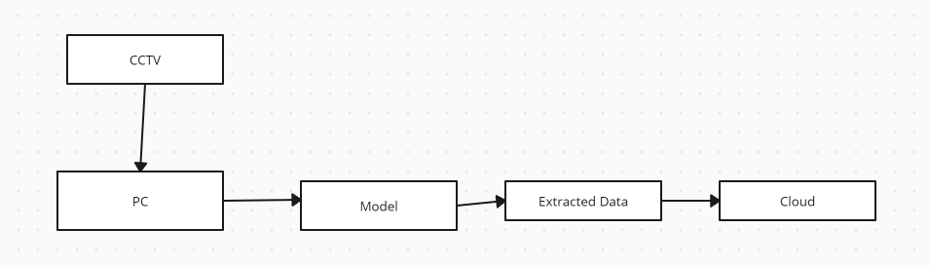
SYSTEM ARCHITECTURE

Slide 20
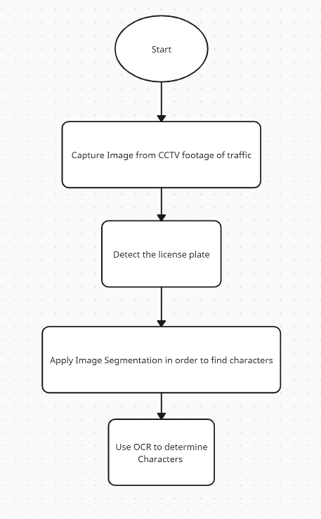
MODULE DESIGN

Slide 21
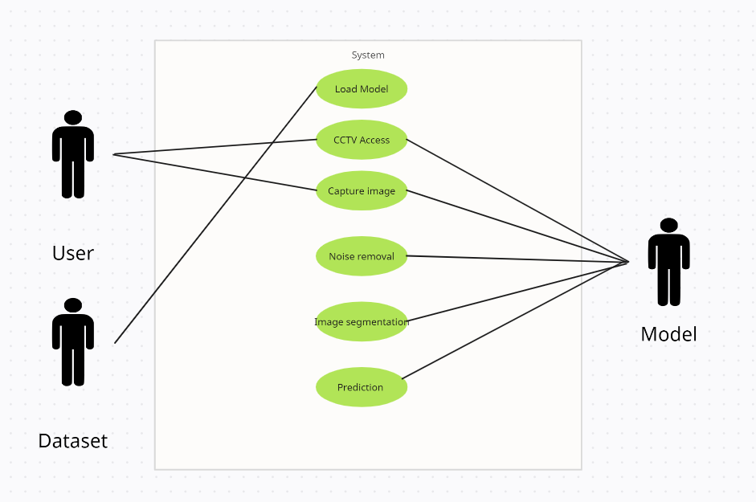
USE CASE DIAGRAM

Slide 22
CONCLUSION
The way we manage and monitor vehicles has been completely transformed by the highly developed technology known as automatic license plate recognition (ALPR). It is a useful tool for a variety of applications, including traffic management, law enforcement, toll road management, security, parking management, and border control. It offers a quick, accurate, and efficient way to identify and track vehicles. Despite some privacy concerns, ALPR is still widely used and its adoption is anticipated to increase in the future as technology develops and its advantages become more and more clear.

Slide 23
REFERENCE
[1] Khan, M.A., Sharif, M., Javed, M.Y., Akram, T., Yasmin, M. and Saba, T., 2018. License number plate recognition system using entropy‐based features selection approach with SVM. IET Image Processing, 12(2), pp.200-209.
[2] Hadavi, S., Rai, H.B., Verlinde, S., Huang, H., Macharis, C. and Guns, T., 2020. Analyzing passenger and freight vehicle movements from automatic-Number plate recognition camera data. European Transport Research Review, 12(1), pp.1-17.
[3] Kulkarni, Y., Bodkhe, S., Kamthe, A. and Patil, A., 2018, March. Automatic number plate recognition for motorcyclists riding without helmet. In 2018 International Conference on Current Trends towards Converging Technologies (ICCTCT) (pp. 1-6). IEEE.
[4] Alghyaline, S., 2022. Real-time Jordanian license plate recognition using deep learning. Journal of King Saud University-Computer and Information Sciences, 34(6), pp.2601-2609.
[5] Pustokhina, I.V., Pustokhin, D.A., Rodrigues, J.J., Gupta, D., Khanna, A., Shankar, K., Seo, C. and Joshi, G.P., 2020. Automatic vehicle license plate recognition using optimal K-means with convolutional neural network for intelligent transportation systems. Ieee Access, 8, pp.92907-92917.
[6] Chen, R.C., 2019. Automatic License Plate Recognition via sliding-window darknet-YOLO deep learning. Image and Vision Computing, 87, pp.47-56.

Slide 24
REFERENCE
[7] Pustokhina, I.V., Pustokhin, D.A., Rodrigues, J.J., Gupta, D., Khanna, A., Shankar, K., Seo, C. and Joshi, G.P., 2020. Automatic vehicle license plate recognition using optimal K-means with convolutional neural network for intelligent transportation systems. Ieee Access, 8, pp.92907-92917.
[8] Laroca, R., Zanlorensi, L.A., Gonçalves, G.R., Todt, E., Schwartz, W.R. and Menotti, D., 2021. An efficient and layout‐independent automatic license plate recognition system based on the YOLO detector. IET Intelligent Transport Systems, 15(4), pp.483-503.
[9] Ali, F., Rathor, H. and Akram, W., 2021, March. License plate recognition system. In 2021 International Conference on Advance Computing and Innovative Technologies in Engineering (ICACITE) (pp. 1053-1055). IEEE.
[10] Li, J., Van Zuylen, H., Deng, Y. and Zhou, Y., 2020. Urban travel time data cleaning and analysis for Automatic Number Plate Recognition. Transportation Research Procedia, 47, pp.712-719.

Slide 25
REFERENCE
[11] Bulan, O., Kozitsky, V., Ramesh, P. and Shreve, M., 2017. Segmentation-and annotation-free license plate recognition with deep localization and failure identification. IEEE Transactions on Intelligent Transportation Systems, 18(9), pp.2351-2363.
[12]Silva, S.M. and Jung, C.R., 2021. A flexible approach for automatic license plate recognition in unconstrained scenarios. IEEE Transactions on Intelligent Transportation Systems, 23(6), pp.5693-5703.
[13] Laroca, R., Severo, E., Zanlorensi, L.A., Oliveira, L.S., Gonçalves, G.R., Schwartz, W.R. and Menotti, D., 2018, July. A robust real-time automatic license plate recognition based on the YOLO detector. In 2018 international joint conference on neural networks (ijcnn) (pp. 1-10). IEEE.
[14] Laroca, R., Zanlorensi, L.A., Gonçalves, G.R., Todt, E., Schwartz, W.R. and Menotti, D., 2021. An efficient and layout‐independent automatic license plate recognition system based on the YOLO detector. IET Intelligent Transport Systems, 15(4), pp.483-503.
[15] Gao, P., Zeng, Z. and Sun, S., 2019. Segmentation-free vehicle license plate recognition using CNN. In Signal and Information Processing, Networking and Computers: Proceedings of the 4th International Conference on Signal and Information Processing, Networking and Computers (ICSINC) 4th (pp. 50-57). Springer Singapore.

